Slide 1
Summer Internship Program
Week 1
Languages chosen:
Java C++

Slide 2
Why I chose Java and C++?
Java:
It is being taught in our current semester
It has a wide scope
I feel the need to practice and explore it more
C++ :
I’ve studied C++ in the school and I really like it
It is asked in many placement exams
I need more practice in writing codes and solving problems in it

Slide 3
Tasks done in C++
I solved 8 problems from LeetCode’s algorithm dashboard namely:
Two Sum
Reverse Integer
Palindrome Number
Roman to Integer
Longest common Prefix
Valid Paranthesis
Merge two sorted lists
Search Insert Position

Slide 4
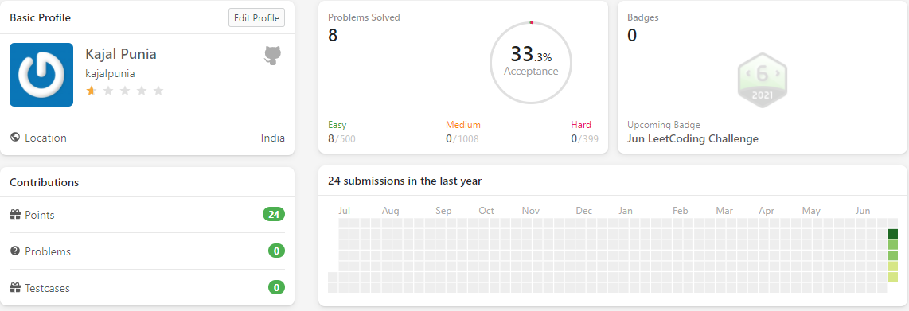
Leetcode profile

Slide 5
Tasks done in Java
I solved 4 practice problems of java from GeeksforGeeks:
Special count
Count odd even
Matrix interchange
Predict the column

Slide 6
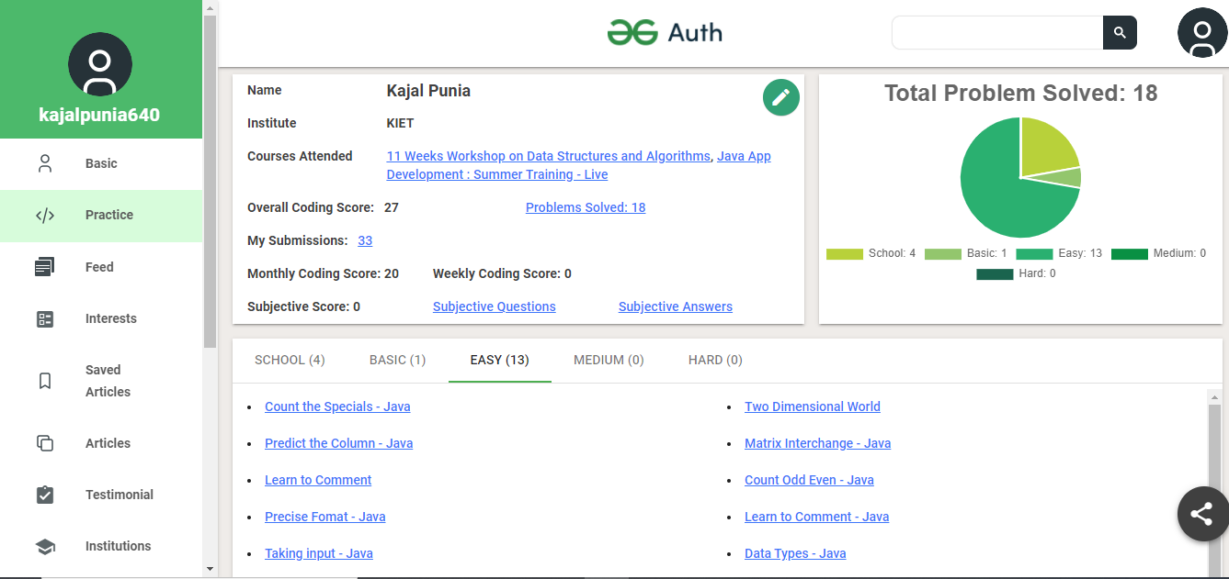
GeeksforGeeks Profile

Slide 7
Github Tasks:
Java:
I created new repository named GeeksforGeeks and uploaded 4 codes in it.
C++:
I created new repository named LeetCode and uploaded 8 codes.

Slide 8
summary
LeetCode submissions in C++ = 8; https://leetcode.com/kajalpunia/
GeeksforGeeks submissions in java= 4; https://auth.geeksforgeeks.org/user/kajalpunia640/practice/
Contributions on GitHub = 12; https://github.com/kajalpunia
Linkedin: https://www.linkedin.com/in/kajal-punia/

Slide 9
Summer Internship Program
Week 1i
Data Structures and Algorithms

Slide 10
Introduction:
A person with never say die attitude
Born and brought up is Muradnagar
Currently pursuing MCA from KIET
Completed my graduation from MMH college Ghaziabad
Schooling from Kendriya Vidyalaya Muradnagar
Strengths: Possess leadership and team work qualities, good communication skills and eager to learn new things
Weakness: Overthinking, it also helps me a bit as I analyse every situation and prepare myself for any problem that might occur in the future. But I’m also working on improving myself by meditation

Slide 11
Data Structures:
A data structure is a particular way of organizing data in a computer so that it can be used effectively.
There are generally four forms of data structures:
Linear: arrays, lists
Tree: binary, heaps, space partitioning etc.
Hash: distributed hash table, hash tree etc.
Graphs: decision, directed, acyclic etc.

Slide 12
Brief Overview of linear data structures:
An array is a finite group of data(with same data type), which is allocated contiguous memory locations, and each element within the array is accessed via an index key (typically numerical, and zero based). Array is a linear data structure.
A linked list is a linear data structure (like arrays) where each element is a separate object. Each element (that is node) of a list is comprising of two items – the data and a reference to the next node.
A stack or LIFO (last in, first out) is an abstract data type that serves as a collection of elements, with two principal operations: push, which adds an element to the collection, and pop, which removes the last element that was added. In stack both the operations of push and pop takes place at the same end that is top of the stack. It can be implemented by using both array and linked list.
A queue or FIFO (first in, first out) is an abstract data type that serves as a collection of elements, with two principal operations: enqueue, the process of adding an element to the collection.(The element is added from the rear side) and dequeue, the process of removing the first element that was added. (The element is removed from the front side). It can be implemented by using both array and linked list.

Slide 13
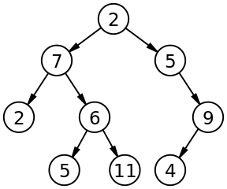
Brief Overview of Non-linear data structures:
The concept of a ‘Tree’ in its simplest terms is to represent a hierarchical tree structure, with a root value and subtrees of children (with a parent node), represented as a set of linked nodes.
A tree contains “nodes” (a node has a value associated with it) and each node is connected by a line called an “edge”. These lines represent the relationship between the nodes.
The top level node is known as the “root” and a node with no children is a “leaf”. If a node is connected to other nodes, then the preceding node is referred to as the “parent”, and nodes following it are “child” nodes.

Slide 14
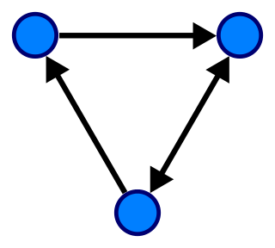
Brief Overview of Non-linear data structures:
A graph is an abstract data type intended to guide the implementation of a data structure following the principles of graph theory.
This data structure consists of:
nodes: points on the graph (also known as ‘vertices’).
edges: lines connecting each node.
The following image demonstrates a ‘directed’ graph (notice the edges have arrows indicating the direction and flow):

Slide 15
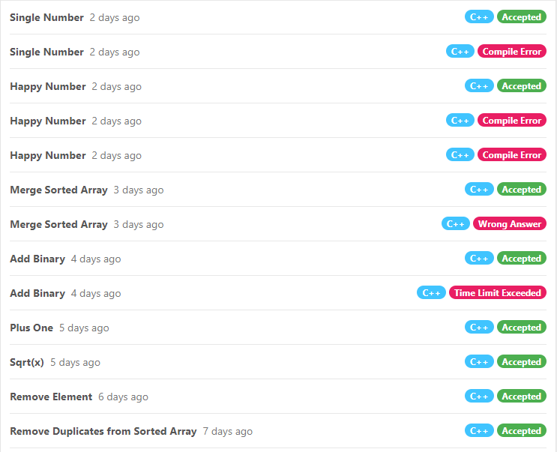
LeetCode:
Total problems
solved=8

Slide 16
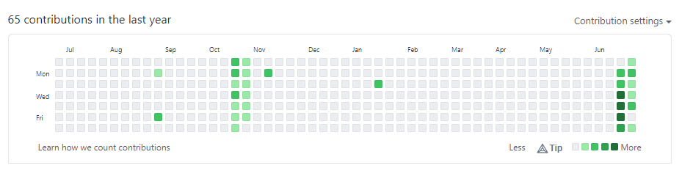
Github:
Total contributions made
in the last week= 10

Slide 17
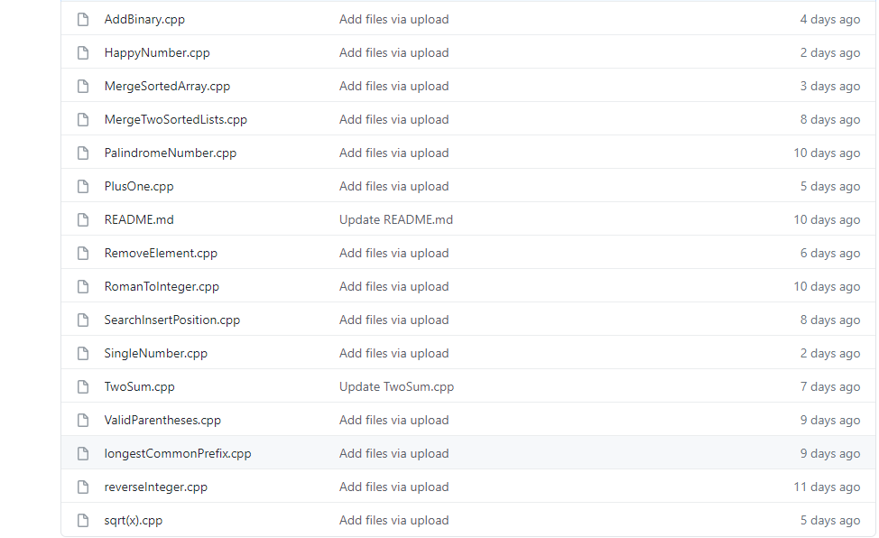

Slide 18
Summer Internship Program
Week iii
HTML CSS

Slide 19
HTML
HTML is the short for Hyper Text Markup Language
HTML was created by Tim Berners-Lee in 1991.
HTML is the standard markup language for creating Web pages
It uses of various tags to format the content. These tags are enclosed within angle braces <Tag Name>. Most of the tags have their corresponding closing tags </Tag Name>.
HTML elements tell the browser how to display the content
Hypertext refers to the way in which Web pages (HTML documents) are linked together. Thus, the link available on a webpage is called Hypertext.
HTML is a Markup Language which means you use HTML to simply "mark-up" a text document with tags that tell a Web browser how to structure it to display.

Slide 20
Basic HTML Document:
<!DOCTYPE html>
<html> (HTML root element)
<head> (Contains page’s HTML metadata)
<title>Page title</title> (Title of the HTML page)
</head>
<body> (Holds content of the HTML page)
<h1>This is a heading</h1> (Headline tag)
<p>Paragraph content</p> (Paragraph tag)
</body>
</html>

Slide 21
<DOCTYPE! html>: This is the document type declaration (not technically a tag). It declares a document as being an HTML document. The doctype declaration is not case-sensitive.
<html>: This is called the HTML root element. All other elements are contained within it.
<head>: The head tag contains the “behind the scenes” elements for a webpage. Elements within the head aren’t visible on the front-end of a webpage. HTML elements used inside the <head> element include:
<style> <title> <noscript> <script> <meta> <link>
<title>The <title> tag is used inside the <head> tag to mention the document title.
<body>: the body tag is used to enclose all the visible content of a webpage. In other words, the body content is what the browser will show on the front-end.
An HTML document can be created using any text editor. Save the text file using .html or .htm. Once saved as an HTML document, the file can be opened as a webpage in the browser.
<h1>This tag represents the heading.
<p>This tag represents a paragraph.

Slide 22
CSS
CSS stands for Cascading Style Sheets
CSS describes how HTML elements are to be displayed on screen, paper, or in other media
It can control the layout of multiple web pages all at once
There are three ways of inserting a style sheet:
1) External CSS: With an external style sheet, you can change the look of an entire
website by changing just one file! Each HTML page must include a reference to the
external style sheet file inside the <link> element, inside the head section.
2) Internal CSS: The internal style is defined inside the <style> element, inside the head
section.
3) Inline CSS: An inline style may be used to apply a unique style for a single element.
To use inline styles, add the style attribute to the relevant element.

Slide 23
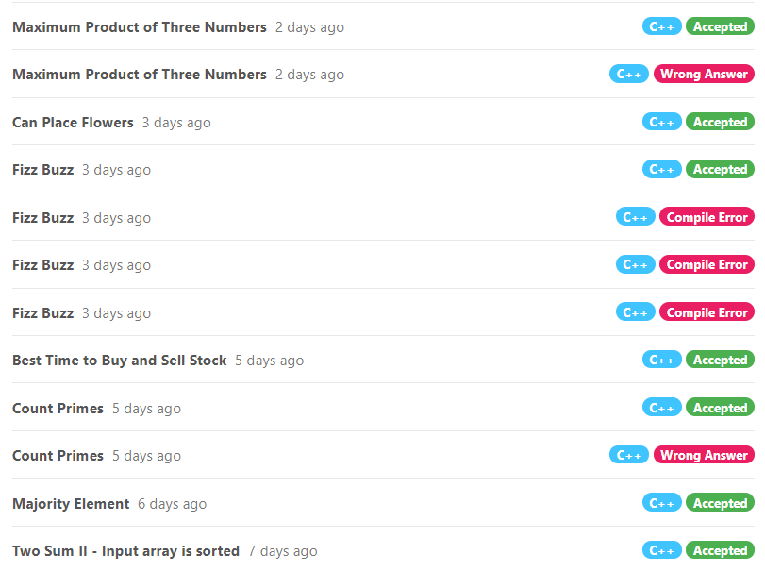
Leetcode

Slide 24
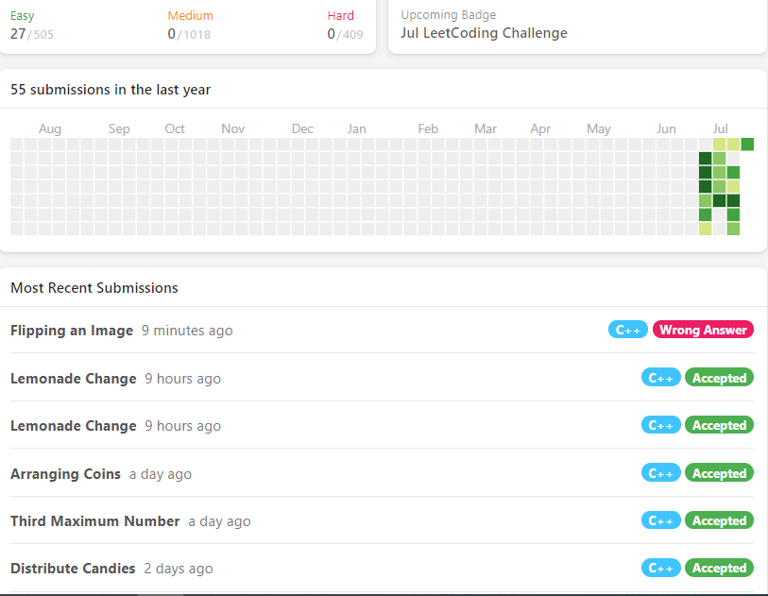

Slide 25
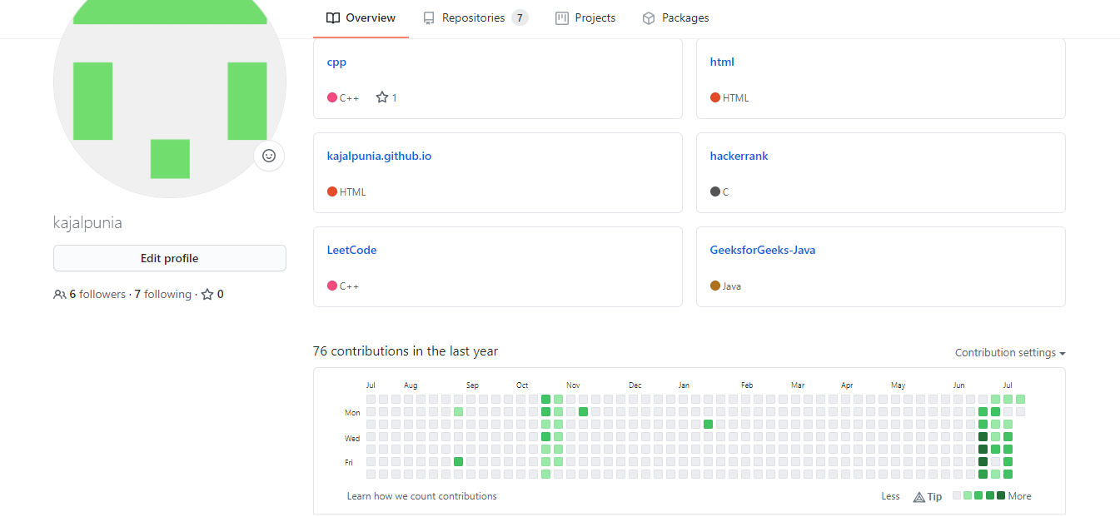
GitHub

Slide 26
Summary
Github Contributions : 11
LeetCode problems Solved : 11
CSS : Inline CSS, Internal CSS
HTML: Creating menu bar, Using bullets, Background image, Use of <aside> tag, use of sections

Slide 27
Summer Internship Program
Week iv
SQL
PL/SQL

Slide 28
SQL
SQL – Structured Query Language
It is a standard query language for accessing and manipulating databases
SQL is used to perform operations on the records stored in the database, such as
updating records
inserting records
deleting records,
creating and modifying database tables
SQL keywords are NOT case sensitive: select is the same as SELECT

Slide 29
Data Types in sql:
Data types are mainly classified into three categories:
String Data types: CHAR(Size), VARCHAR(Size), BINARY(Size), ENUM(val1, val2, val3,...) etc.
Numeric Data types: BIT(Size), INT(size), FLOAT(size, d), BOOL etc.
Date and time Data types: DATE (YYYY-MM-DD, in mysql), DATETIME(fsp), YEAR etc.

Slide 30
Types of sql commands:
SQL commands are mainly categorized into five categories as:
DDL – Data Definition Language: CREATE, DROP, ALTER, TRUNCATE, RENAME
DQl – Data Query Language: SELECT
DML – Data Manipulation Language: INSERT, UPDATE, DELETE
DCL – Data Control Language: GRANT, REVOKE
TCL – Transaction Control Language: COMMIT, ROLLBACK, SAVEPOINT

Slide 31
Some basic sql queries:
Create Table:
create table "tablename"
("column1" "data type",
"column2" "data type",
...
"columnN" "data type");
Drop Table:
DROP TABLE "table_name";
Rename Table:
ALTER TABLE table_name
RENAME TO new_table_name;
Truncate Table:
TRUNCATE TABLE table_name;
Delete Table:
DELETE FROM table_name;

Slide 32
Pl/sql
PL/SQL - Procedural Language extension of SQL
PL/SQL is a block structured language
It was developed by Oracle Corporation in the late 1980s
It is not case sensitive
PL/SQL supports object-oriented programming.
Great combination of data manipulating power of SQL and data processing power of procedural languages.
It brought many other elements to SQL like conditional statements, loops, arrays, string, exceptions, collections, records, triggers, functions, procedures, cursors etc.

Slide 33
Advantages of PL/SQL:
PL/SQL is strongly integrated with SQL and supports both static & dynamic SQL.
It allows sending an entire block of statements to the database at one time.
Saves time on design and debugging by strong features, such as exception handling, encapsulation, data hiding, and object-oriented data types.
Applications written in PL/SQL are fully portable.
PL/SQL provides high security level
Provides access to predefined SQL packages.
Provides support for developing Web Applications and Server Pages.

Slide 34
Loops in pl/sql
Exit loop:
LOOP
statements;
EXIT;
{or EXIT WHEN condition;}
END LOOP;
For loop:
FOR counter IN initial_value .. final_value LOOP
LOOP statements;
END LOOP;
While loop:
WHILE <condition>
LOOP statements;
END LOOP;
Basic loop:
LOOP
Sequence of statements;
END LOOP;

Slide 35
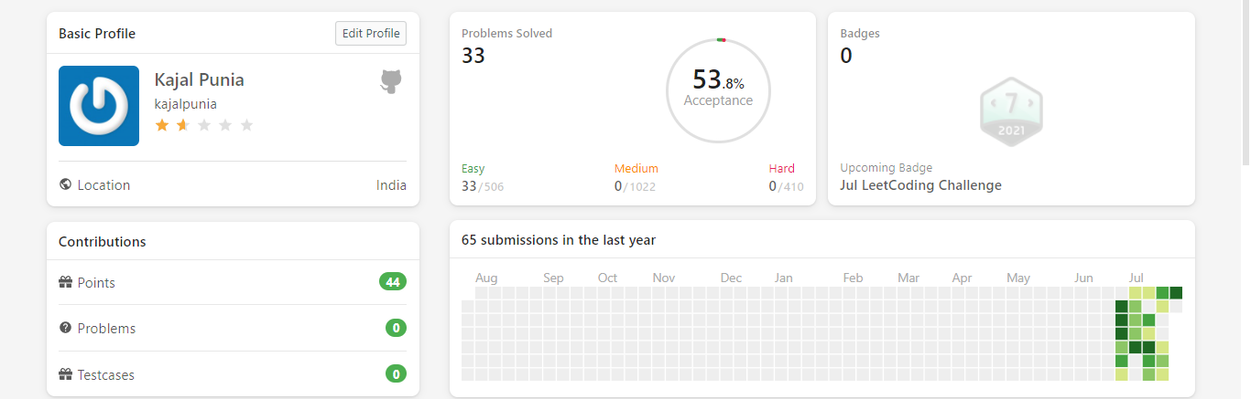
Leetcode :

Slide 36
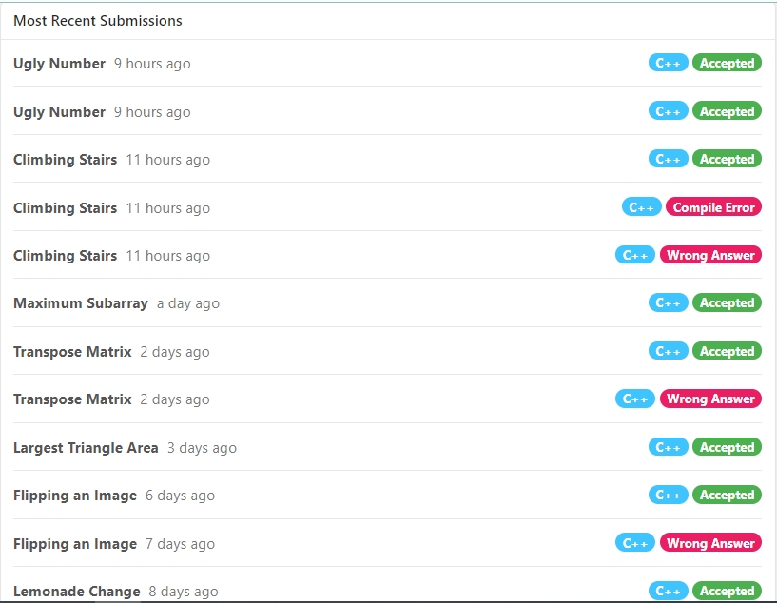
Problems
Solved:

Slide 37
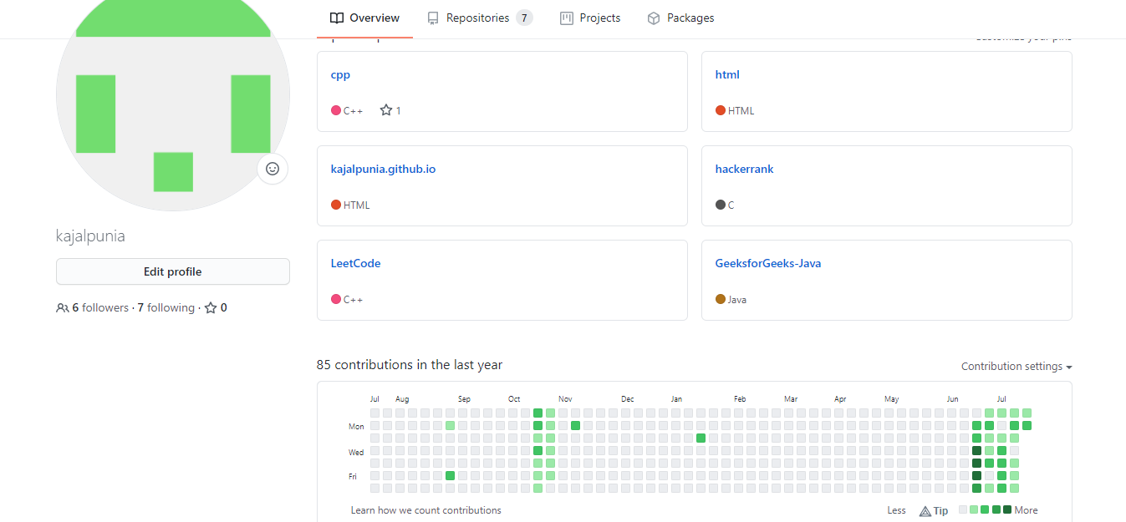
Github:

Slide 38
Summer internship program
Week v
Blockchain

Slide 39
What is blockchain?
Blockchain is a shared, immutable ledger that facilitates the process of recording transactions and tracking assets across a peer-to-peer network.
Using this technology, the participants can perform transactions without the need for a central certifying authority.
As the name suggests, blockchains store data in blocks that are then chained together.
Blockchain can be both centralized and decentralized.
In centralized blockchain full control stays with the central authority whereas in a decentralized way no single person or group has control—rather, all users collectively retain control.
Now the two terms Distributed and Decentralized should not be confused with each other. Distributed means computation is spread across multiple nodes instead of just one. Decentralized means no node is instructing any other node as to what to do.

Slide 40
Key Elements of a blockchain:
Distributed ledger technology: All network participants have access to the distributed ledger and its immutable record of transactions.
Immutable records: No participant can change or tamper with a transaction after it’s been recorded to the shared ledger.
Smart contracts: To speed transactions, a set of rules — called a smart contract — is stored on the blockchain and executed automatically. A smart contract can define conditions for corporate bond transfers, include terms for travel insurance to be paid and much more.

Slide 41
Types of Blockchain:
Public Blockchain: A public blockchain is a non-restrictive, permission-less distributed ledger system. A node or user which is a part of the public blockchain is authorized to access current and past records, verify transactions or do proof-of-work for an incoming block, and do mining. Example: Bitcoin, Ethereum, Litecoin
Private Blockchain: A private blockchain is a restrictive or permission blockchain operative only in a closed network. Private blockchain networks are deployed for voting, supply chain management, digital identity, asset ownership, etc.
Consortium Blockchain: A consortium blockchain is a semi-decentralized type where more than one organization manages a blockchain network. Consortium blockchains are typically used by banks, government organizations, etc.
Hybrid Blockchain:A hybrid blockchain is a combination of the private and public blockchain. With such a hybrid network, users can control who gets access to which data stored in the blockchain. Only a selected section of data or records from the blockchain can be allowed to go public keeping the rest as confidential in the private network.

Slide 42
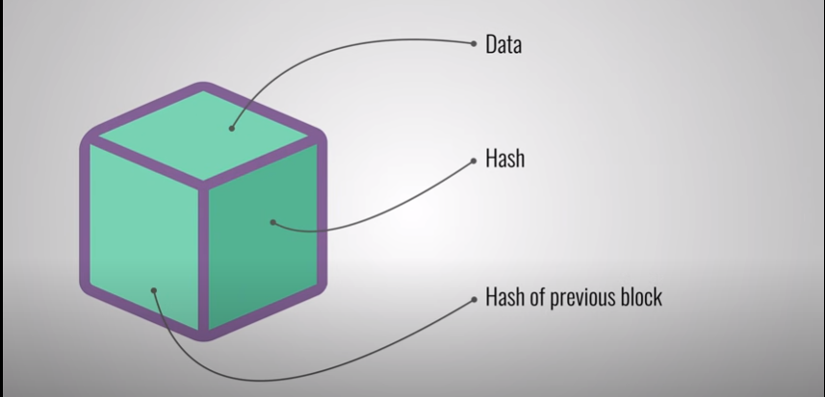
Elements of a block:

Slide 43
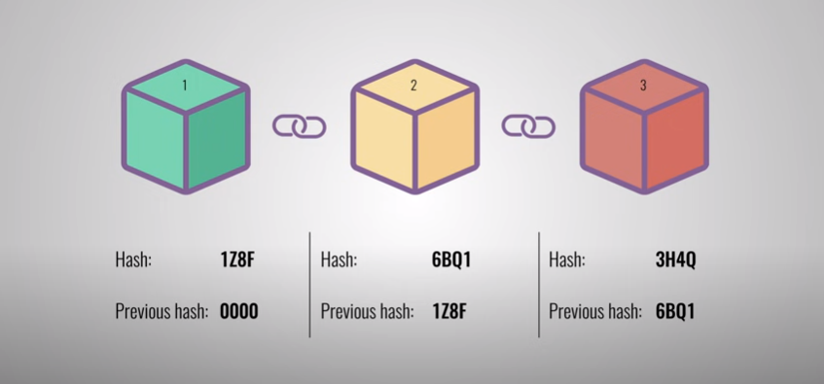

Slide 44
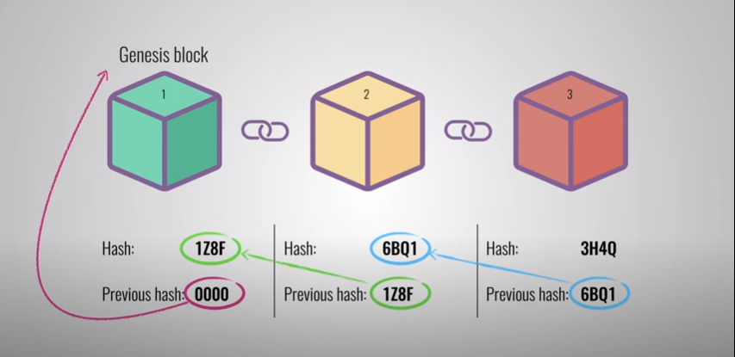

Slide 45
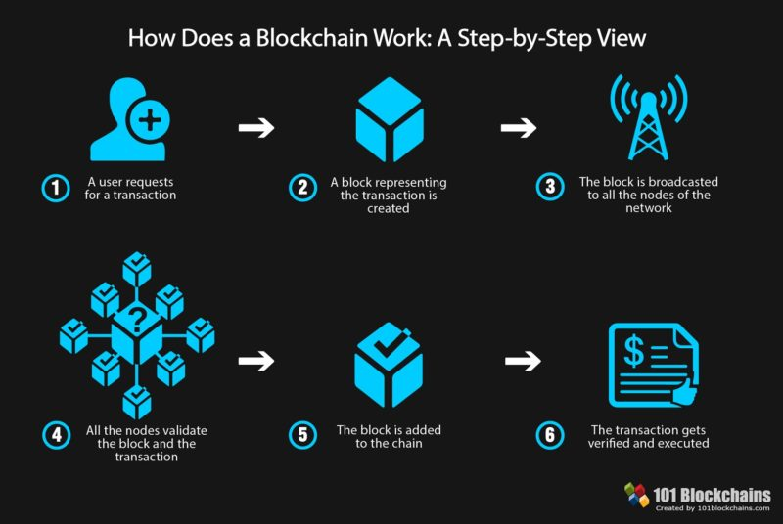

Slide 46
Advantages of blockchain:
Better Transparency: Every node on the network has a copy of the ledger so every transaction is open to all the users to view.
Reduced transaction costs: No need of the middle man because it provides peer-to-peer transaction facility.
Faster transaction settlements
Enhanced Security: Everyone on the network is provided with a unique identity which is linked to their account, proof of work and every transaction is verified by other users.
Traceability: The transactions done are transparent and hence, easy to trace.

Slide 47
Applications of blockchain:
Cryptocurrency exchange
Secure sharing of medical data
Cross-border payments
Anti-money laundering tracking system
Supply chain and logistics monitoring
Voting mechanism
Real estate processing platform

Slide 48
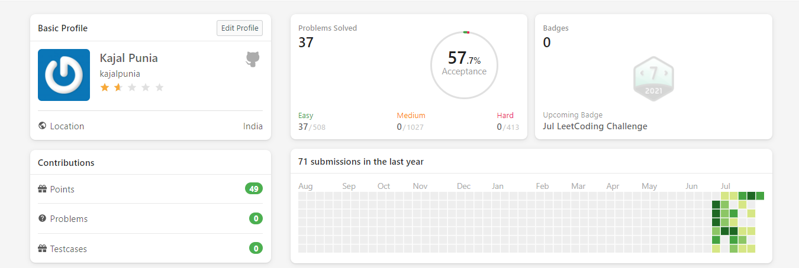
Leetcode dashboard:

Slide 49
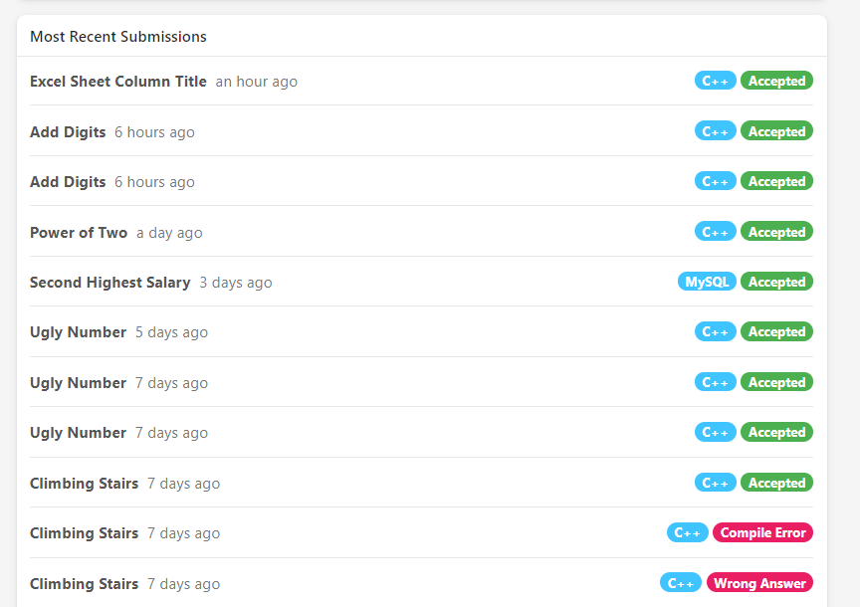
Problems
Solved:

Slide 50
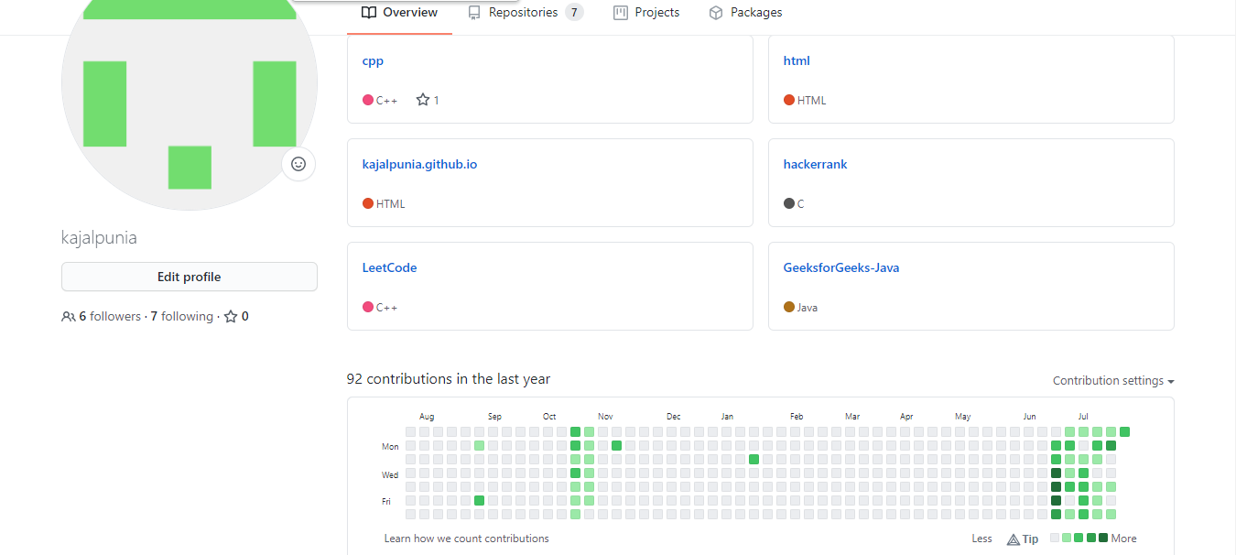
Github Dashboard:

Slide 51


